Slide 1
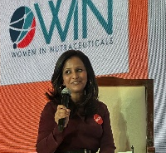
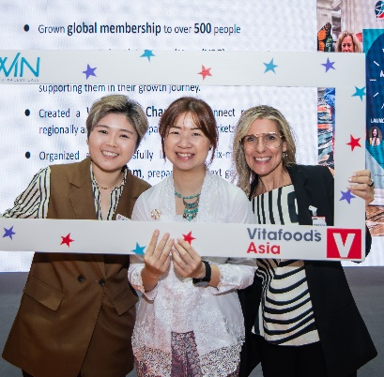
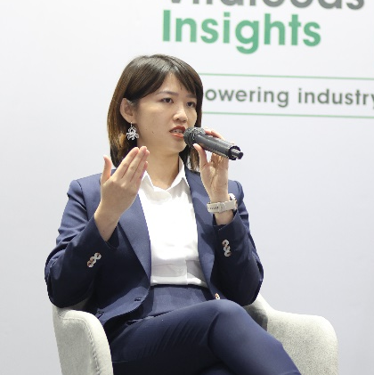

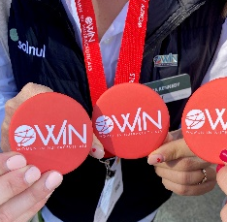
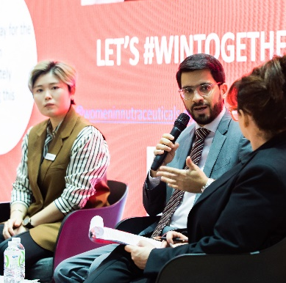
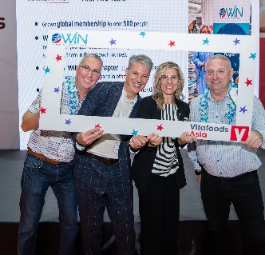
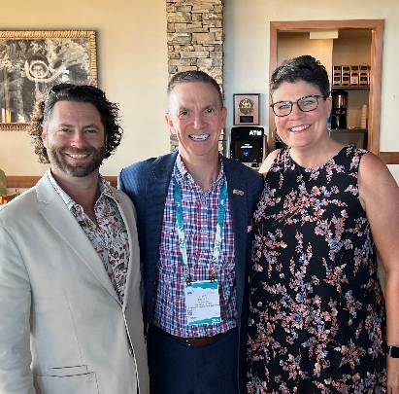
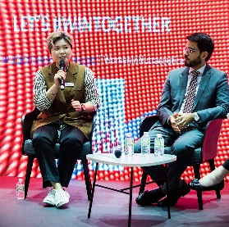
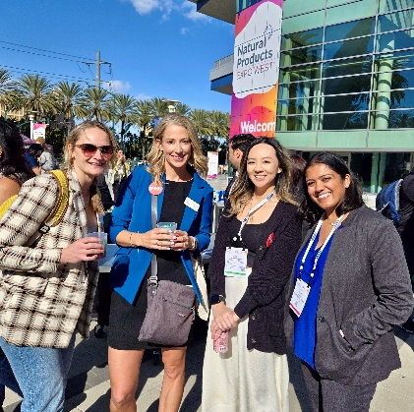
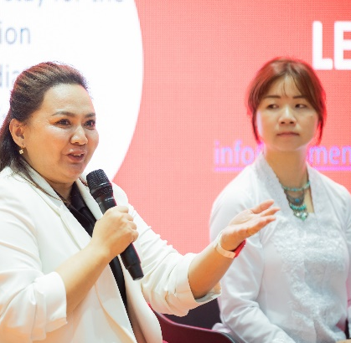
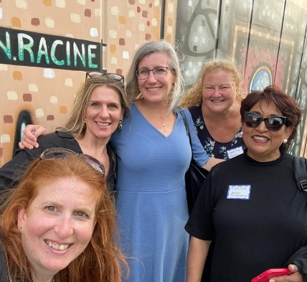
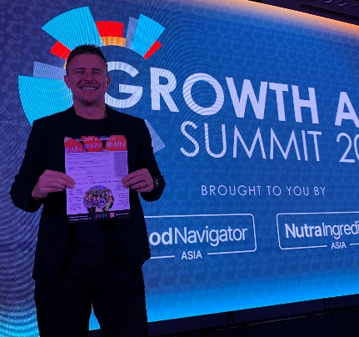
BREAKING BARRIERS –
WOMEN IN NUTRACEUTICALS IN
INDIA AND BEYOND
BHARAT NUTRAVERSE
SEPTEMBER 2025

Slide 2
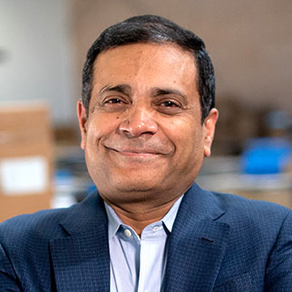
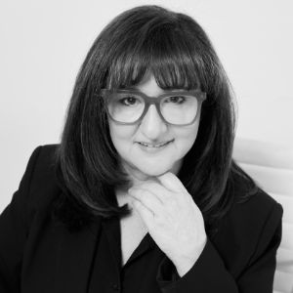
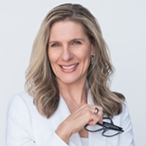
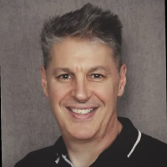
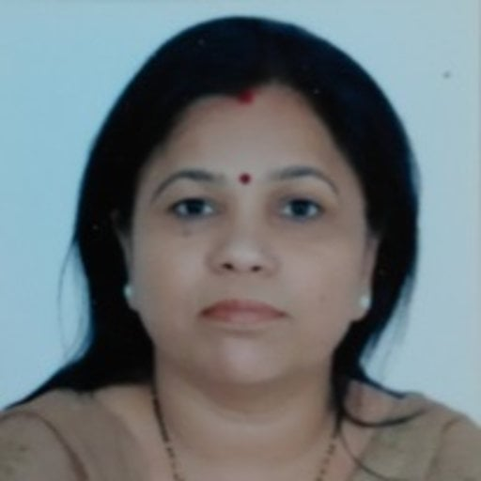


WIN SPOTLIGHT SPEAKERS
Anand Swaroop
Founder & President
Cepham Inc
Board Member, WIN
Gillian Fish
Michelle Martin
Kenn Israel
Dr Meenakshi Singh
Aldrine Olive D Souza
Founder & CEO
The 6AM Agency
Founding Member &
Regional Co-Chair APAC
WIN
President & CEO
Cypress Minerals
Founding Member &
Vice President, WIN
& A Thousand Plus
Founder
M/s BeyondBrands
Uzbekistan
Regional Co-Chair EU, WIN
Chief Scientist
Technology Management Directorate
Council of Scientific & Industrial Research,
New Delhi
Global Marketing Lead
Bio-Gen Extracts Pty Ltd
Notes:
OUR VISION
We were founded in 2022 to achieve economic and social equality in this great nutraceutials industry
OUR MISSION
To create an environment where women have an equal place in leadership
Where women can reap personal fulfilment, social and economic benefits
Our membership
GENDER – it is important that we have male and female members – women cannot do this alone – currently 91% female
58% have a higher education than a bachelors degree
17% sit outside of USA and fast growing

Slide 3

































Sponsors & Partnerships
Platinum Sponsors
Gold Sponsors
Silver Sponsors
2024 Person of the Year: Women in Nutraceuticals
Notes:
The biggest brands in the world ….

Slide 4
























Sponsors & Partnerships
Founding Partners
Partners
2024 Person of the Year: Women in Nutraceuticals

Slide 5
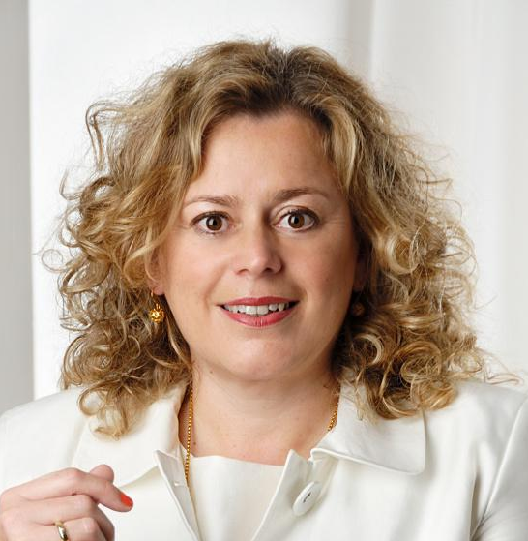
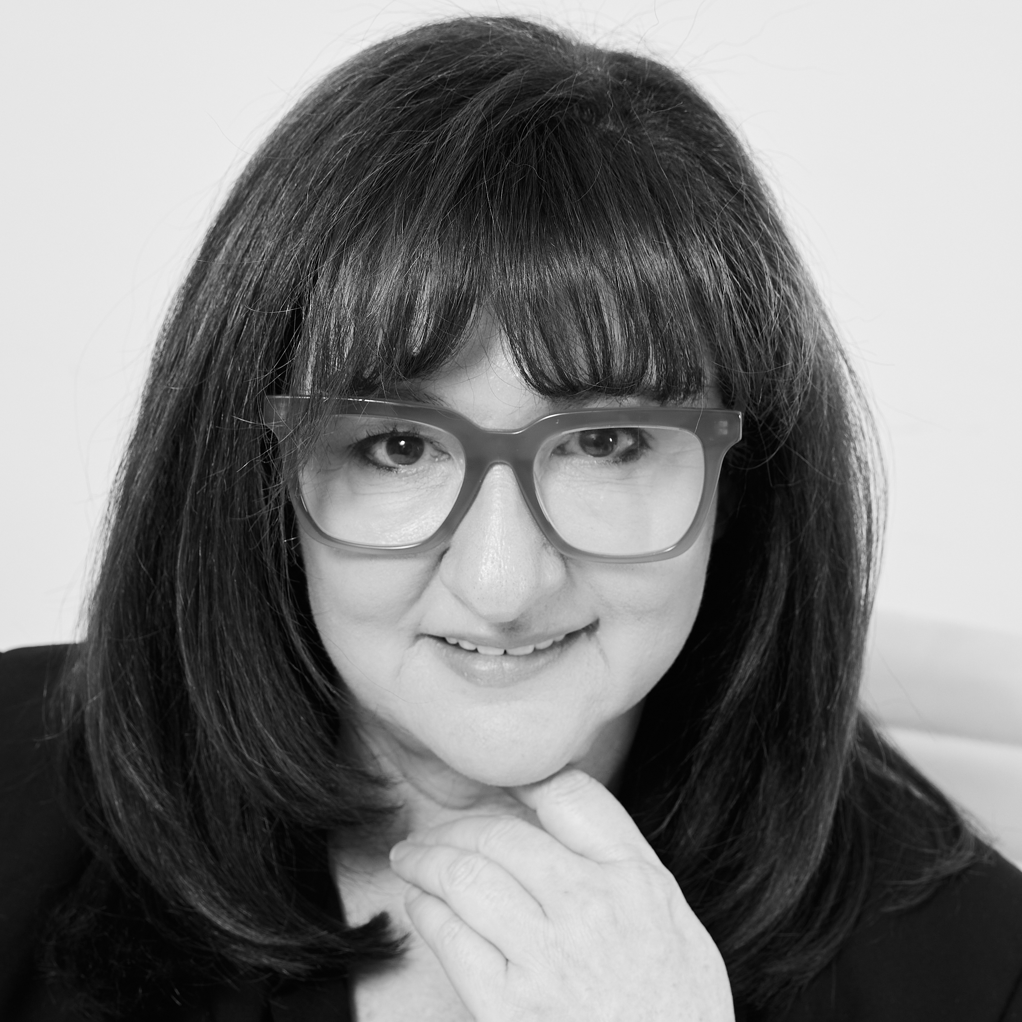
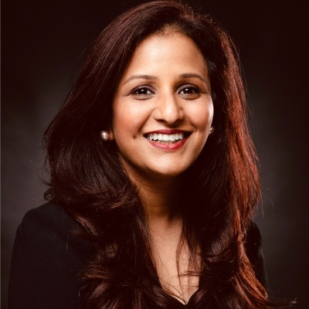
WIN GLOBAL COMMITTEE APAC
Board Liaison
Dr. Sybille Buchwald-Werner
CEO Newdays
Co-Chair APAC
Gillian Fish
Founder & CEO The 6AM Agency
Co-Chair APAC
Global Liaison India
Rajat Mittal Shah
Cofounder & Executive Director, Nutriventia
Notes:
Now for to show you how the global rollout is taking place
Dr Sybille Buchwald-Werner – Global Board Liaison
Myself and Rajat Shah, Regional Co-chairs APAc

Slide 6
WIN’s Regional Committees
Board Liaison
GLOBAL
Co-Chairs
APAC
Co-Chairs
EU
Co-Chairs
US
Co-Chairs
Africa
Co-Chairs
Middle East
Gillian Fish
Rajat Shah
Kenn Israel
Dr Julia Wiebe
…
…
…
Kelly Thornton: IC Administrative Support​
Silvi Siddhu: IC Co-Chair​
LINE SUB-CHAIR PER COUNTRY
REGIONAL
EXPERT SUB-CHAIR PER COUNTRY
ANZ
MALAYSIA
Media Partner
Legal
Marketing
Sponsorship
SINGAPORE
ESG
Finance
Programming
TAIWAN
Executive Search
CHINA
THAILAND
Notes:
Overview
1 – global board liaison
2 – Country chairs
3 – Country Expert Committees

Slide 7
WHY JOIN WIN?
SCIENCE
VOLUNTEER
MEMBERSHIP
PROGRAMMING
MENTORSHIP
MENTORSHIP
SPONSORSHIP
ENTREPRENEURSHIP
ENGAGEMENT
ENTREPRENEURSHIP
MARKETING & COMMS
MAKE A LASTING IMPACT
Notes:
How can you get involved?
Volunteer – hundreds of volunteers contributing daily, an hour a day, 2 hours a week, or more
Membership – sign up for $100 and join a community rich in activity – weekly webinars, training, mentoring, popups, networking, exchange of ideas, build connections
Mentorship – become a mentor
Sponsorship – without which WIN could not exist
In a multitude of ways – science, marketing etc

Slide 8




Why align with win?
EMPOWER WOMEN
MENTOR FUTURE LEADERS
ADVANCE RESEARCH
DRIVE BUSINESS GROWTH
Support gender equity for women to lead, grow and thrive
Guide the next generation of women industry leaders
Prioritise scientific inquiry for women's health needs
Tap into diverse perspectives for innovation
Notes:
WHAT’S THE WHY?
Empower women – in your companies
Mentor future leaders – Guide the next generation of female leaders
Advance research – critical to evolve as rapidly as possible – the women’s health category – more scientific research by women on women’s related health needs
Drive business growth – connect on innovation, discuss, advance the entire industry
IMPORTANTLY –leave a legacy of gender equality where women and men have the same opportunities, rewards and focus in this great wellbeing industry

Slide 9

FIND A HIGHER PURPOSE
DRIVE COLLECTIVE IMPACT
Enable teams to contribute to greater cause
AMPLIFY INDIVIDUAL EFFORTS
Achieve more through collaborative action
CULTIVATE SENSE OF PURPOSE
Align personal aspirations with organizational goals
INSPIRE COMMITMENT
Motivate through meaningful impact stories
Notes:
So what is the why for you personally and your teams?
I have seen it in action for me, for my team
Drive a collective impact – teams are proud to lean in, contribute – be it writing a social media post to help marketing, or supporting events at VFA or other – team bonding is strengthened by contributing to a common cause
Amplify Individual efforts – allow our folk to shine – reward them, champion them internally for what they do, you will reap the rewards
Engage with WIN personally and for your teams – to cultivate a higher sense of purpose – trust me, it delivers = my team is so proud, and volunteer in many ways and they are championed in the agency..

Slide 10




Let’s Connect!
info@womeninnutraceuticals.org
womeninnutraceuticals.org
Notes:
Now is the time, to lean in, to unlock personal and professional potential
Thank you to Kerry and NHPNZ for this time and support
Ends#

