Slide 1

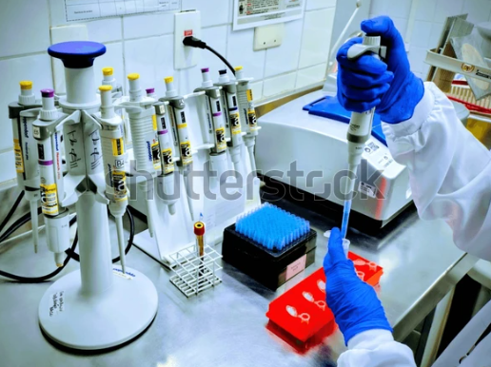

CEO Conclave
Indian Nutraceutical Ecosystem: Are we ready to conquer the global market

Slide 2
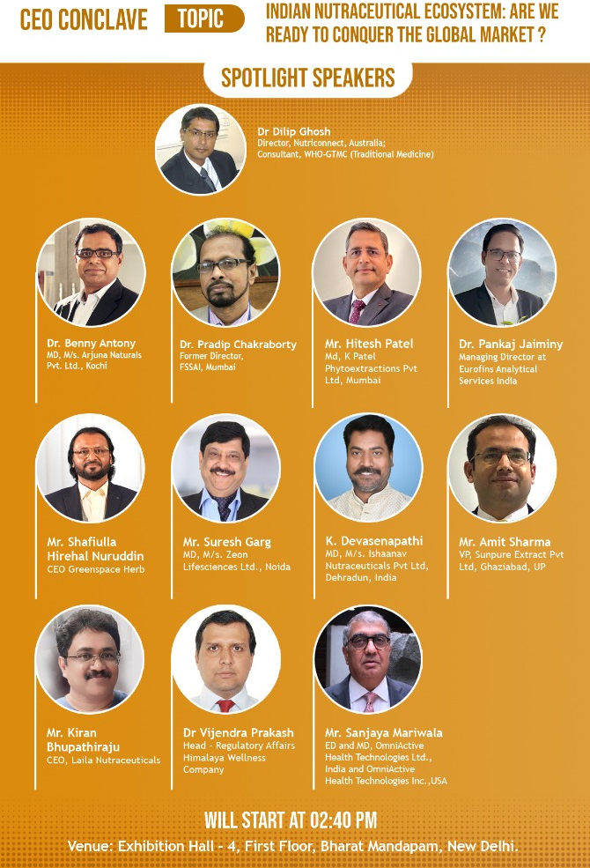

OUR Panel Today

Slide 3

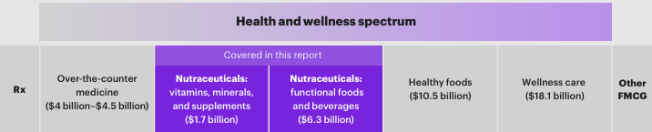
India’s health and wellness market is valued at about $40 billion

Slide 4
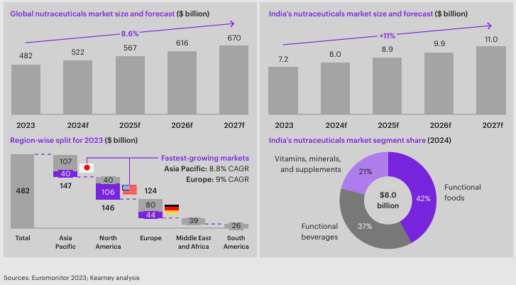
The Indian market is projected to reach $11 billion by 2027

Slide 5
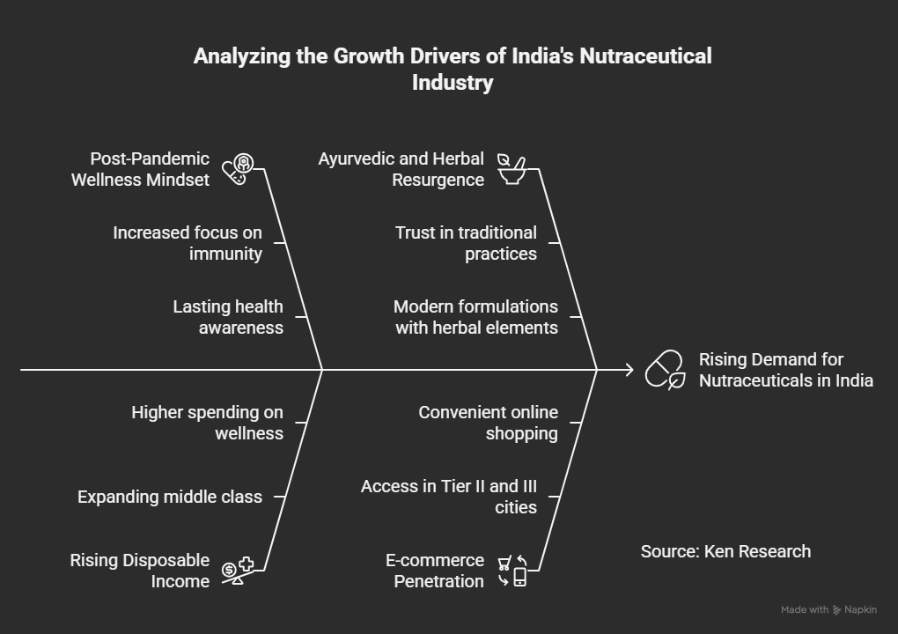

Slide 6

Pitch for Today
There is a strong believe in western world that Indian nutraceutical industries have non-compelling scientific evidence for product efficacy, consumer skepticism due to limited clinical trials, and insufficient regulatory clarity and standardization for health claims. Are you agree with this statement?
What are the challenges of nutraceutical industries are facing in India?
What lies ahead for the India Nutraceutical market growth for both domestic and international market?

Slide 7
New Horizons in Nutraceutical business:
Where Tradition meets Innovation

Slide 8

OUR Speakers Today

Slide 9
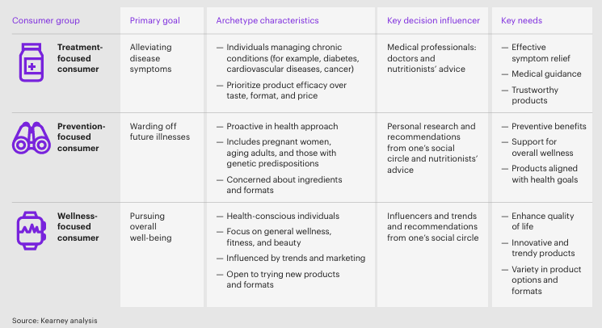
The nutraceutical consumer landscape can be categorized into three groups
But post-pandemic market is shifting from Treatment to Prevention and Wellness

Slide 10
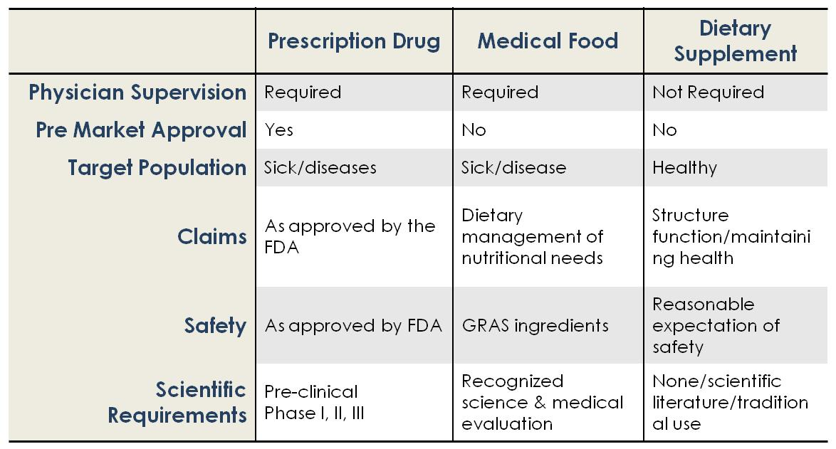
Drug-Nutraceuticals-Medical Foods – A Comparison

Slide 11


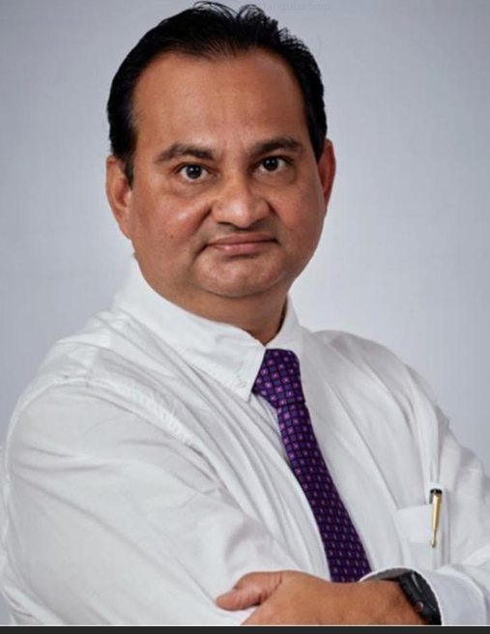
OUR Panellists Today

Slide 12
Pitch for Today
What are the factors pushing the boundaries of nutraceutical development
What consumers want different things from their nutraceutical products?
Do you think today’s evidence-based, clinically validated products to be considered as a new ‘prescription’?
How technology enhances nutraceuticals efficacy?
Where to focus for future nutraceutical success?

