Slide 1
Indian Nutraceutical ecosystem: Are we ready to conquer the global market?
Dr. Benny Antony Ph. D
Joint Managing Director
Arjuna Natural Private Limited

Slide 2
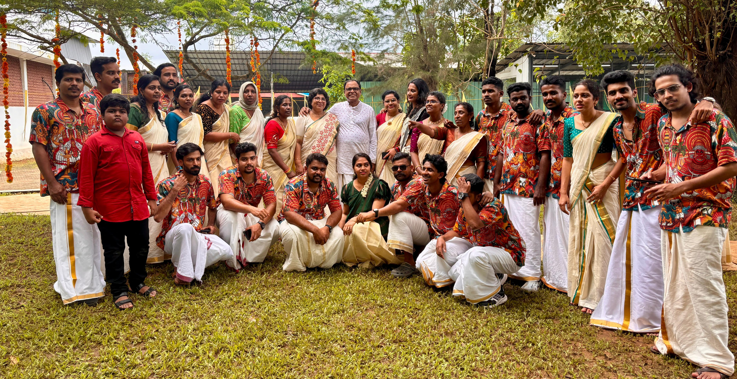


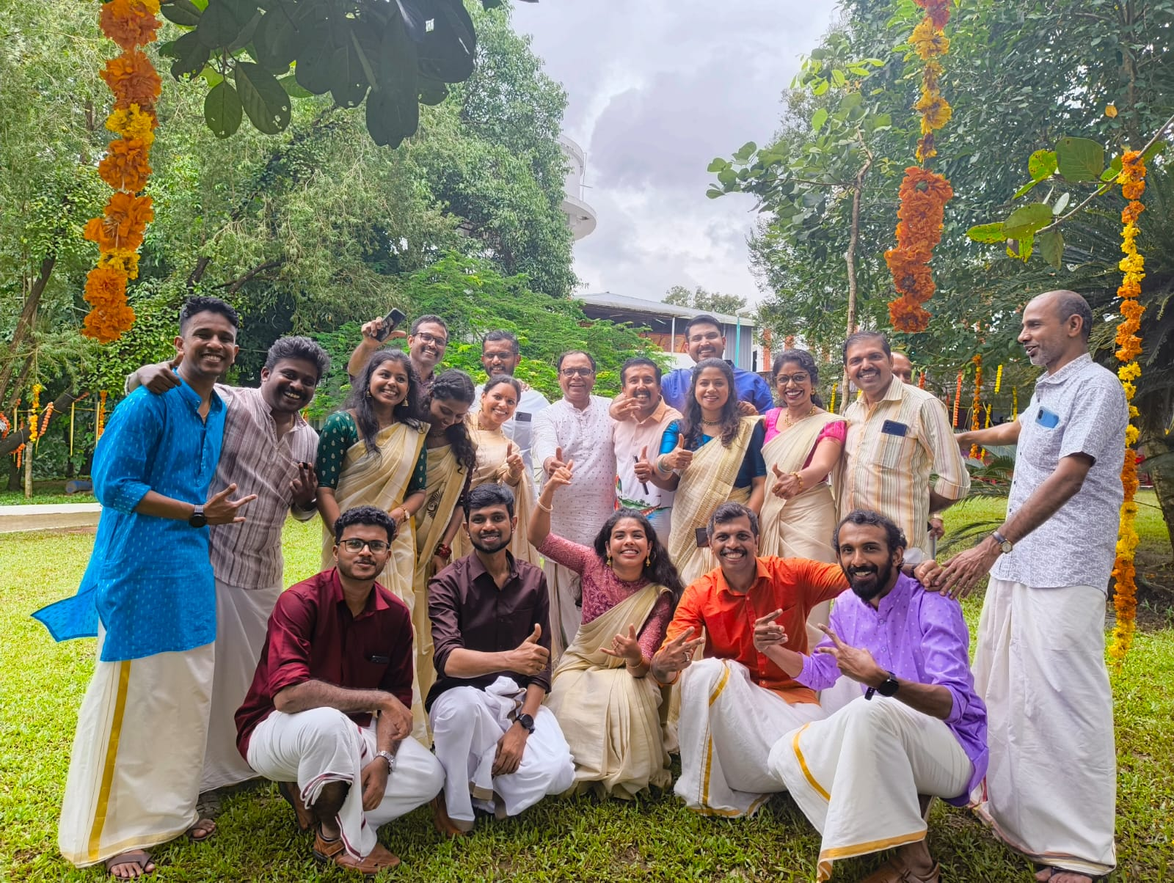


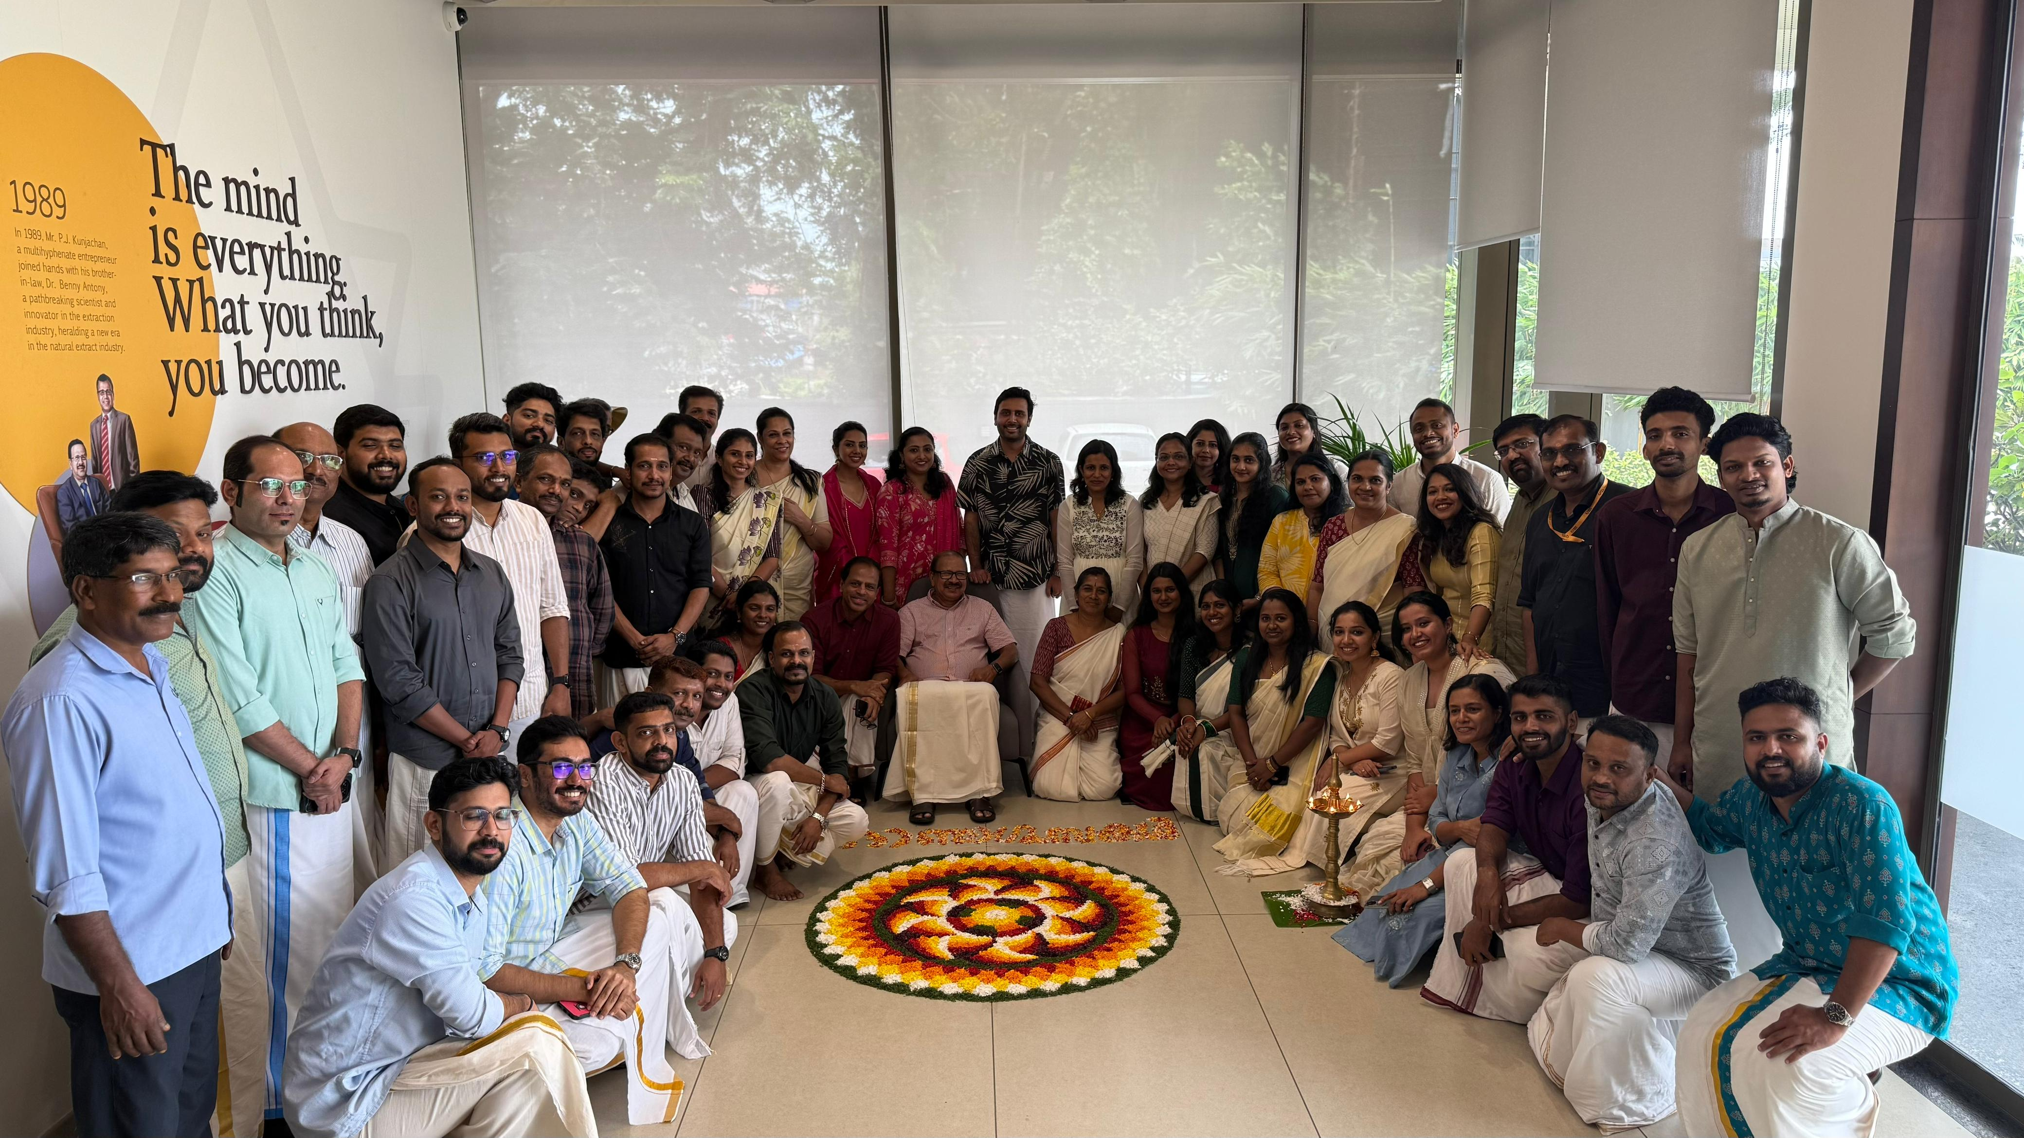

Slide 3
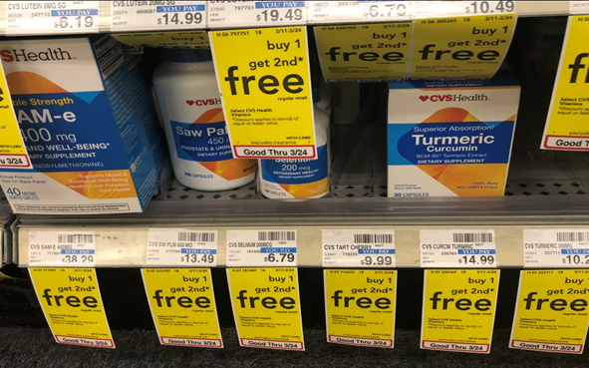
Global Market Overview
Global nutraceutical industry valued at ~USD 590B+ (2024)
Strong growth driven by health awareness, preventive healthcare, and aging population
Market expected to grow to approximately USD 919.1 billion by 2030, reflecting a CAGR of ~7.6%
Ref : Grand view Research Nutraceuticals Market Size And Share |
Industry Report, 2030

Slide 4
Indian Market
India’s gold mine is our “traditional knowledge”
The Indian nutraceutical industry is one of the fastest-growing globally.
Valued at around USD 8–9 billion in 2024, it is projected to reach USD 20–30 billion by 2030, growing at a CAGR of 13–15%.
India contributes significantly to the Asia-Pacific nutraceuticals market which is one of the largest worldwide.
Ref : India Nutraceuticals Market Growth Rate, Industry Insights and Forecast 2025-2032

Slide 5
India vs China: Market Advantage
China – Nutraceutical market ~USD 60 B (TCM ~USD 86 B)
Strong domestic demand, mostly TCM-driven
Very few TCM products accepted globally
Research mostly in Chinese → Limited global visibility
India – Nutraceutical market ~USD 8–9 Billion
Global impact is large might be due to our research being published in English mostly
Top global nutraceuticals: Turmeric, Ashwagandha, Boswellia, Fenugreek etc – are all Indian origin
Indian Nutraceuticals has strong worldwide acceptance

Slide 6
Key Growth Drivers of Indian Market
Lifestyle diseases: Rising cases of diabetes, obesity, cardiovascular diseases, and joint problems.
Preventive healthcare mindset: Post-COVID, Indians are more focused on immunity and wellness.
Growing middle class: Rising income and health awareness.
Traditional knowledge: Ayurveda and botanicals (turmeric, ashwagandha, amla, fenugreek etc.) are being globally recognized.
Government support: FSSAI regulations, AYUSH Ministry, and “Make in India” initiatives are boosting the sector.

Slide 7
The Way Forward – Indian Nutraceuticals
To strengthen its global presence, India must move beyond tradition into science-driven innovation.
Global consumers demand:
Quality & Standardization – non-negotiable.
Scientific Validation – evidence-backed and clinically proven.
Innovation in Formats – gummies, sachets, ready-to-drink, beyond tablets & capsules.
Brand Building – strong global Indian nutraceutical brands.
Policy Support – continuous guidance & commercial support.
With the right strategy, India can move from being a supplier to becoming a significant player in preventive health worldwide.

Slide 8
Tariffs - Strategic Path Forward
50% tariff on Indian nutraceuticals in US – severe blow as US is main export destination. Creates urgency to rethink India’s export dependence
Strengthen Indian domestic market – huge potential still untapped.
Diversify exports into Europe, Asia-Pacific, Middle East, Africa.
Build global Indian nutraceutical brands with strong quality & research.
Requires policy & government support to enable competitiveness.
GST council have cut rates to 5% - the news today

Slide 9

Arjuna Journey
🌱 One of the first botanical extraction company in India since 1989
🏛 First DSIR-recognized private lab in Kerala since 2001
📜 150+ global patents protecting innovations
📖 190+ scientific publications validating products
🌍 Exporting natural solutions to 70+ countries worldwide
🎯 Mission: Deliver safe, effective, and trusted nutraceuticals from India to the world
🧪First to develop several pioneering natural products, setting benchmarks in the industry

Slide 10
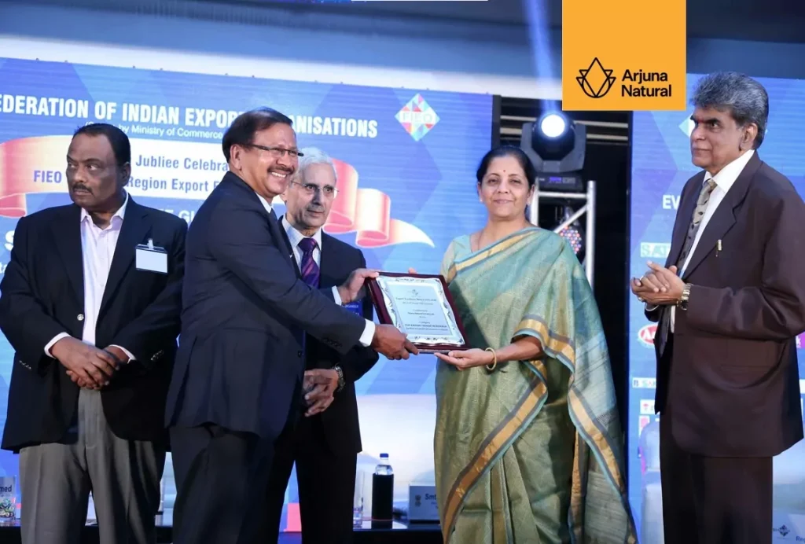


Slide 11
Conclusion
🚀 Fast-Growth Industry: India’s nutraceutical sector is on a rapid growth phase.
🧪 Innovative Research: Critical to engage everyday consumers and build global competitiveness.
✅ Scientific Credibility: Robust toxicity & efficacy studies, backed by reputed CROs, are essential.
💡 Delivery Innovation: Beyond capsules/tablets – convenient, consumer-friendly formats are the future.
🎯 Dosage Optimization: Effectiveness depends on precise, balanced dosing.
🌿 Quality Sourcing: Ensuring pesticide-free, high-quality raw materials remains a key challenge. Now-a-days markets are implementing more and more stringent regulations,
With innovation, scientific validation, and quality focus, India can position itself as a global nutraceutical powerhouse.

Slide 12

HAPPY ONAM

